Slide 1
Style guide
When Robots Bleed

Slide 2
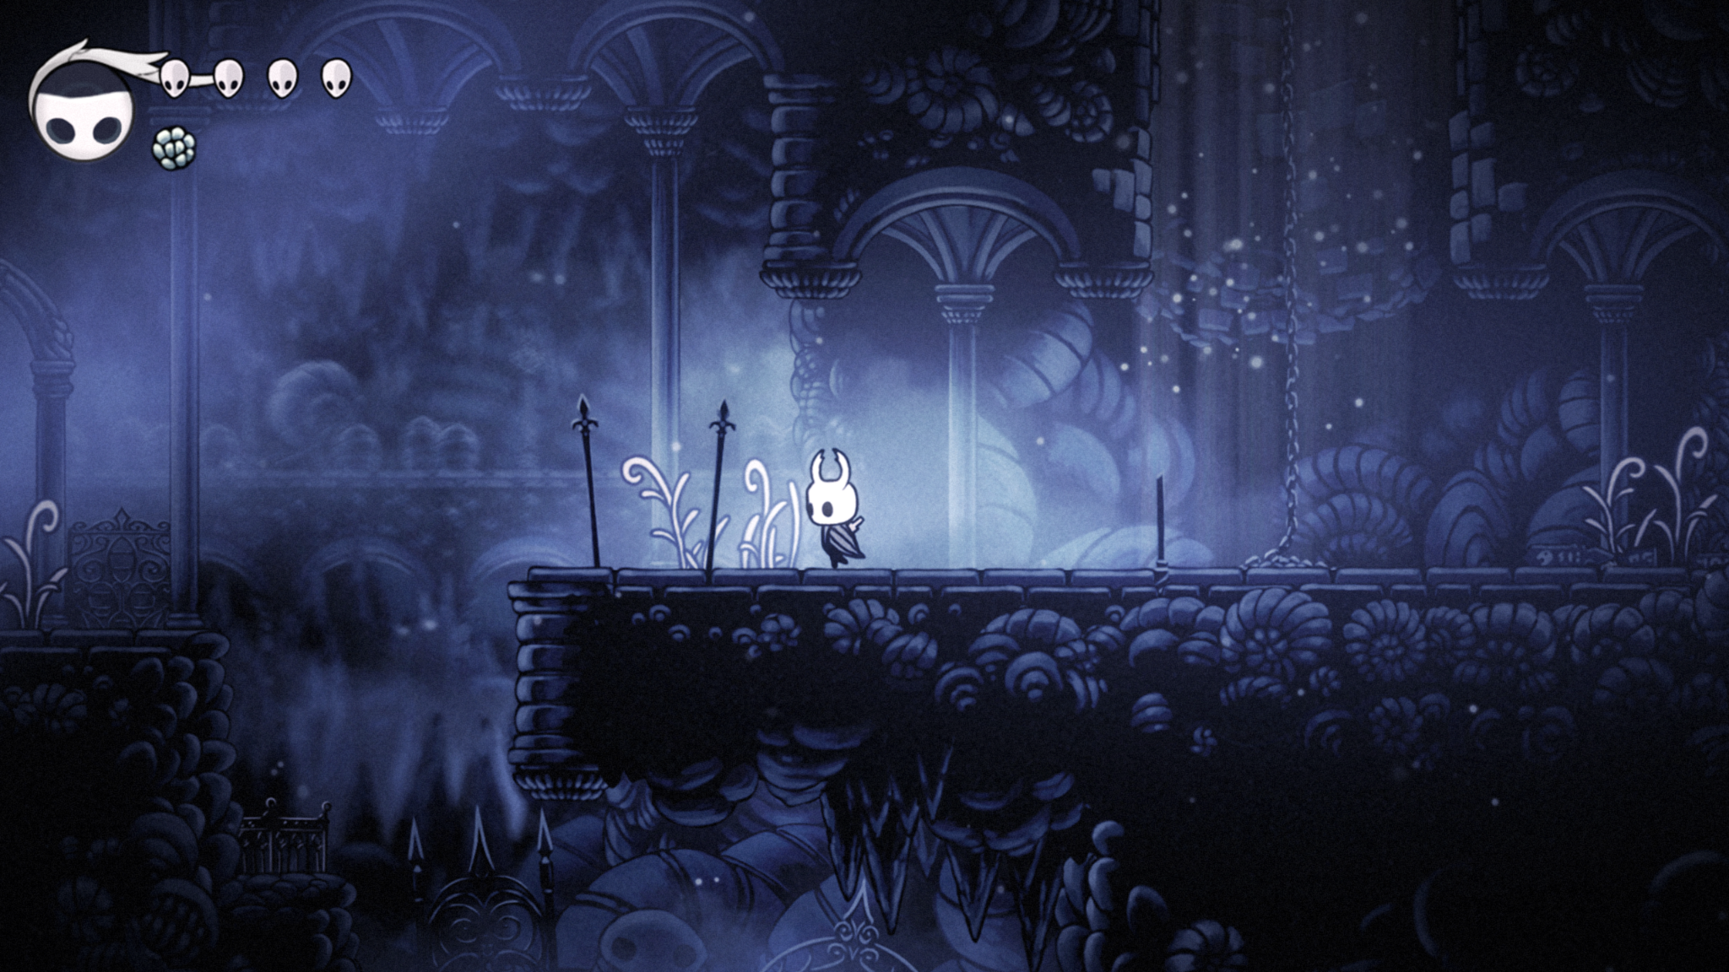
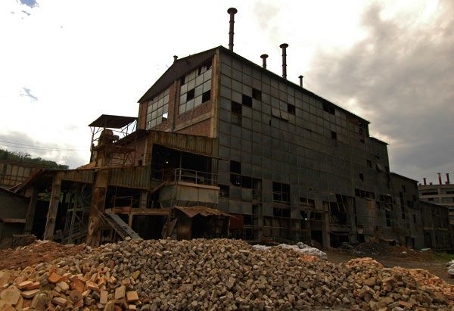
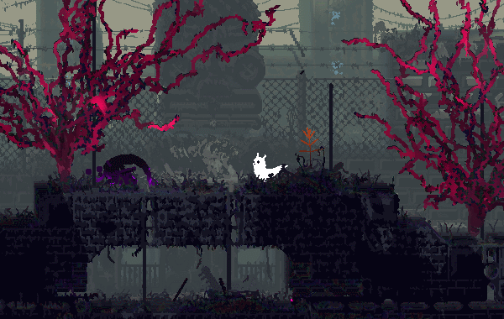
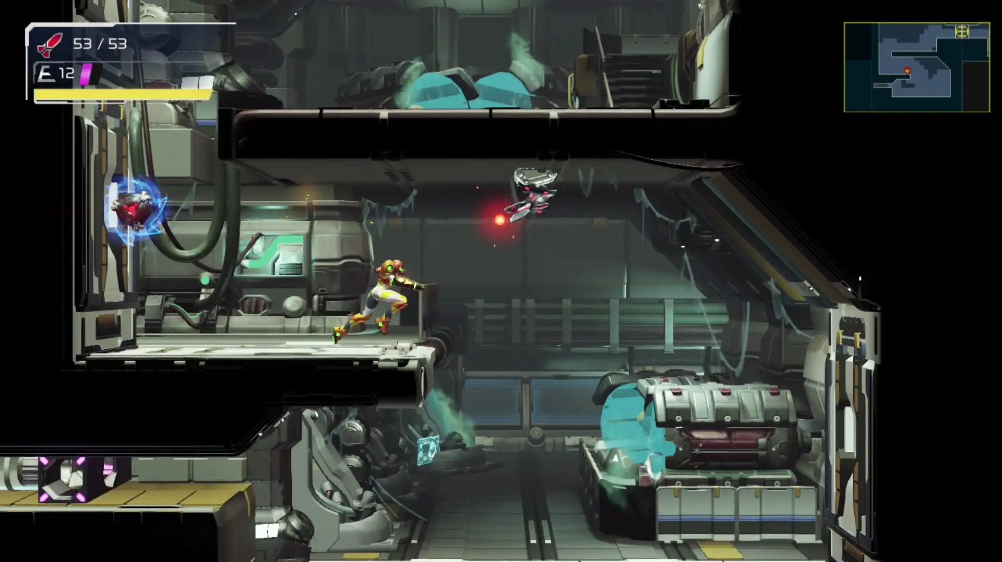
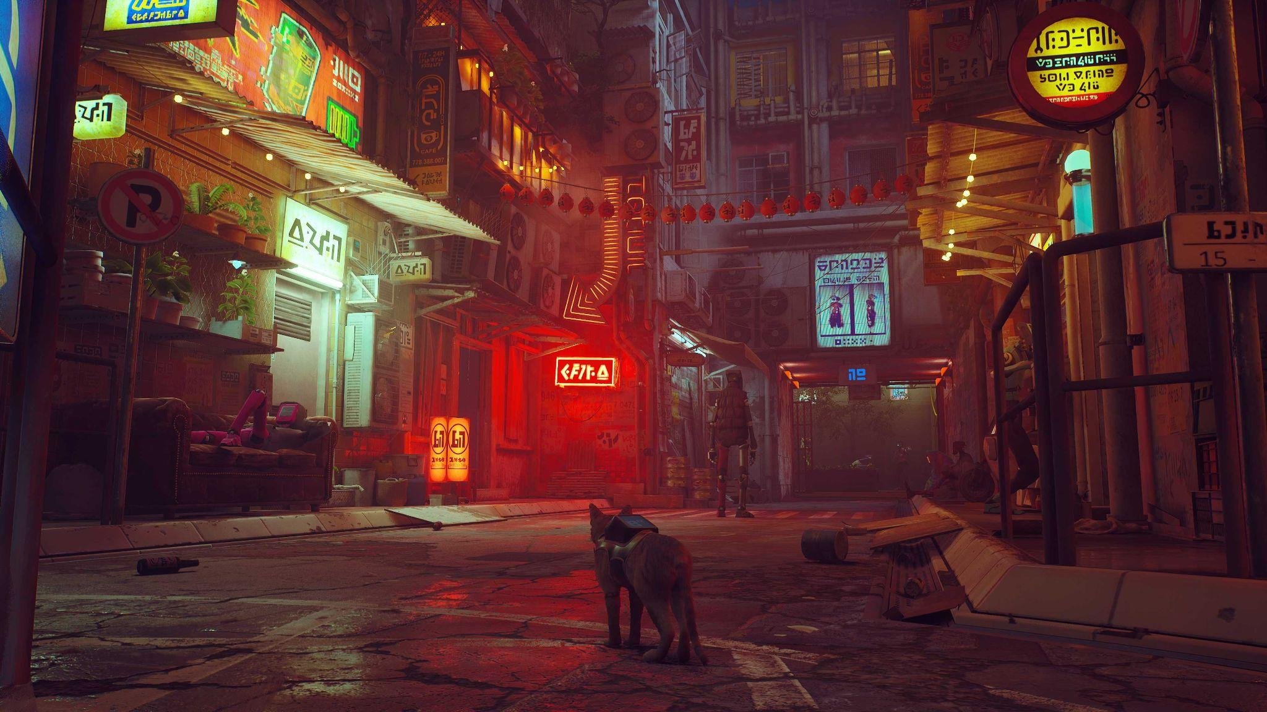
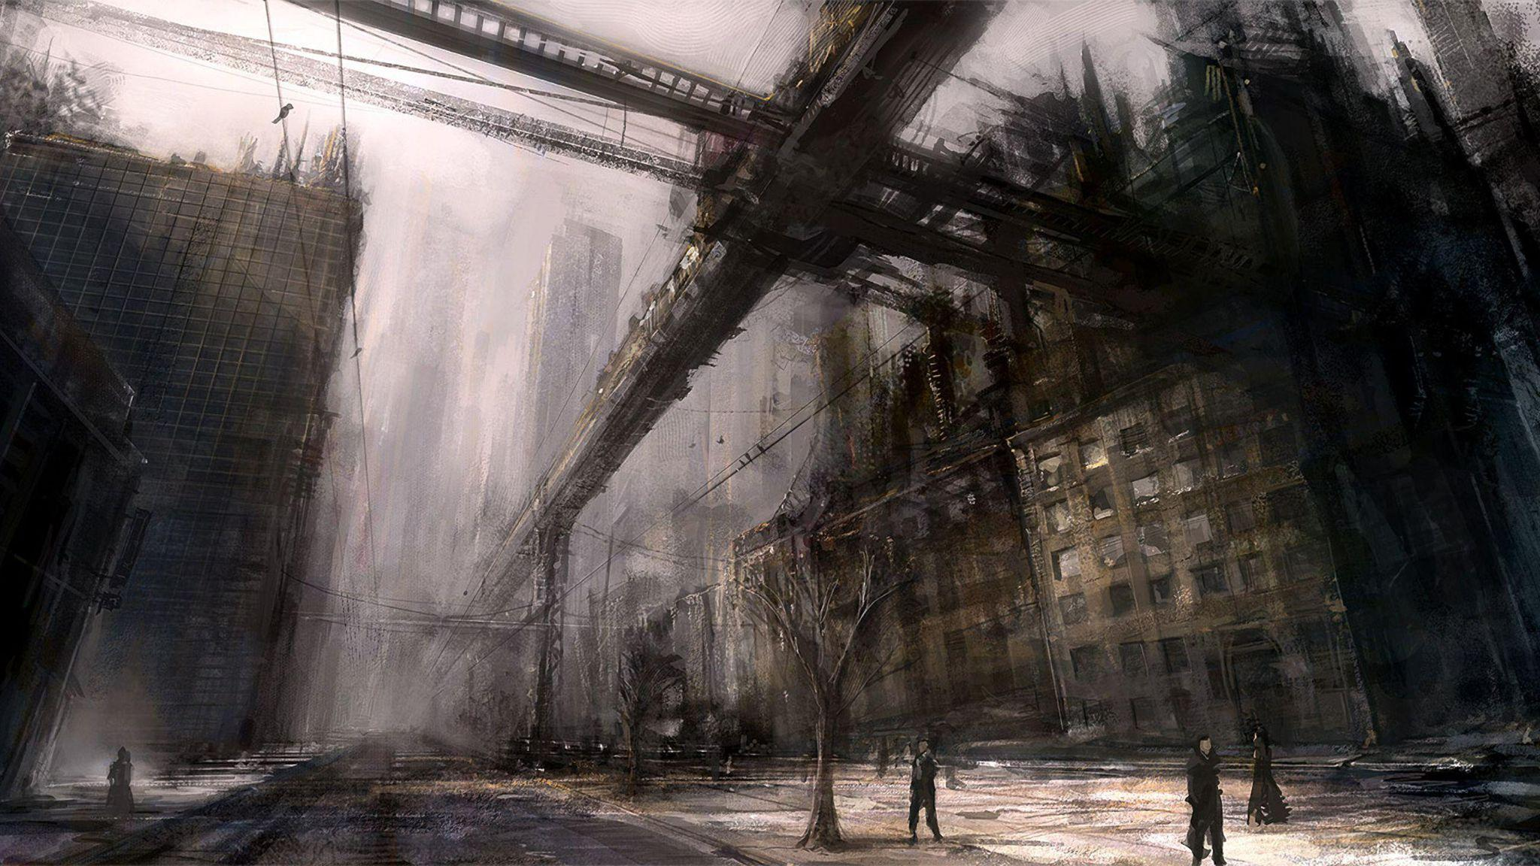
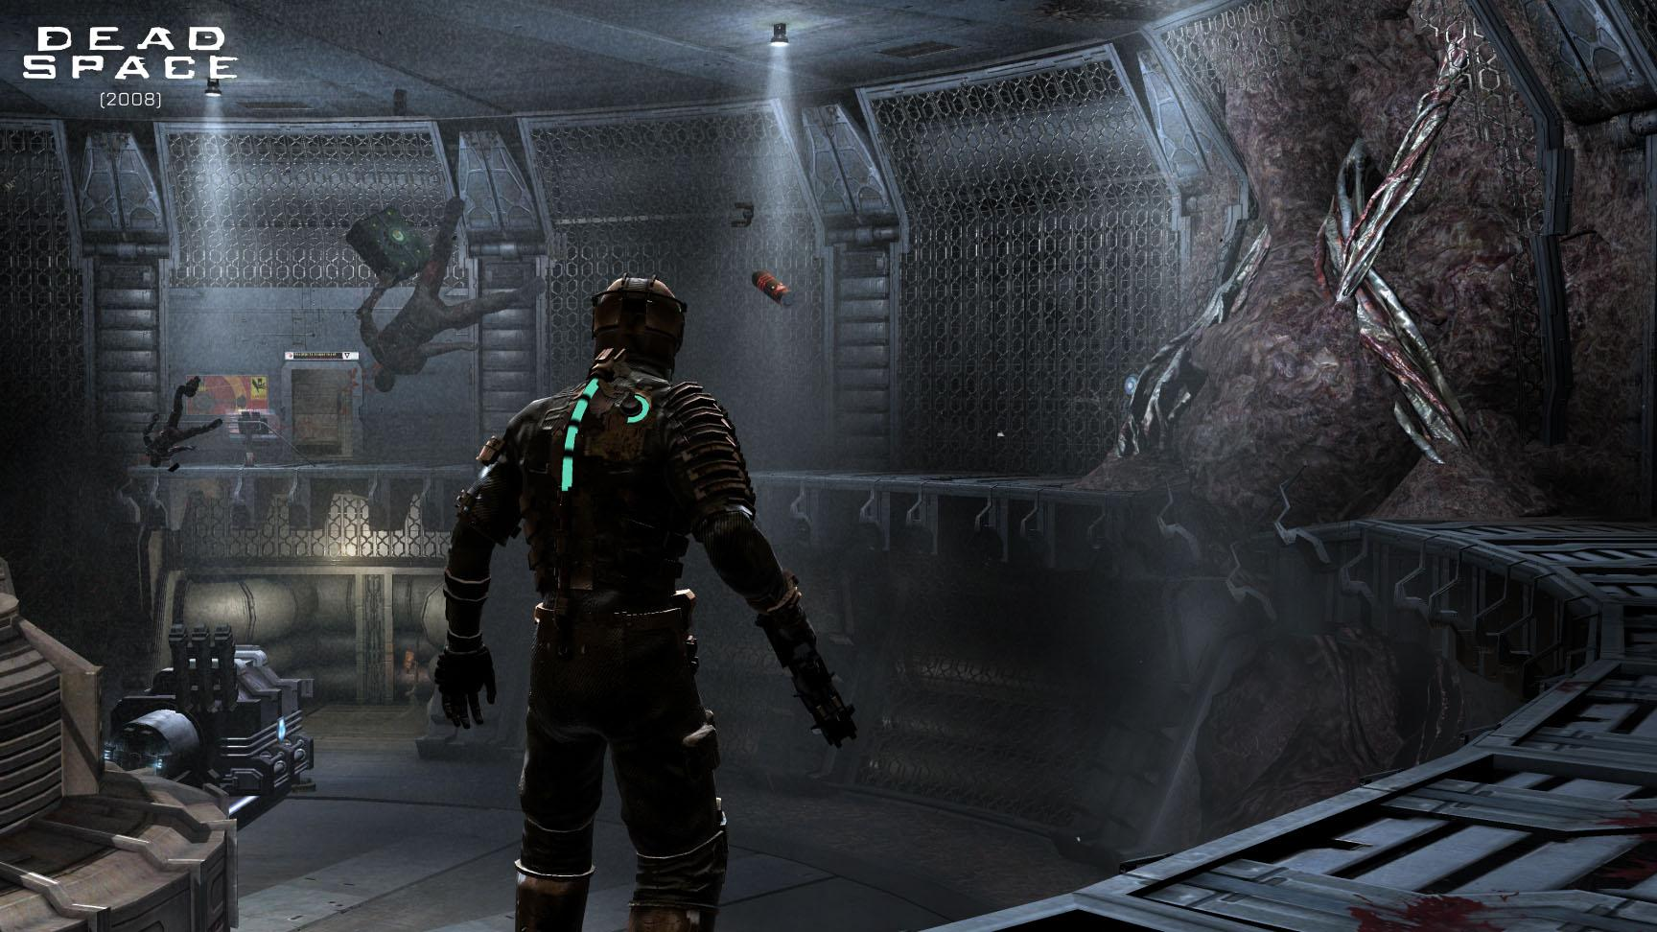
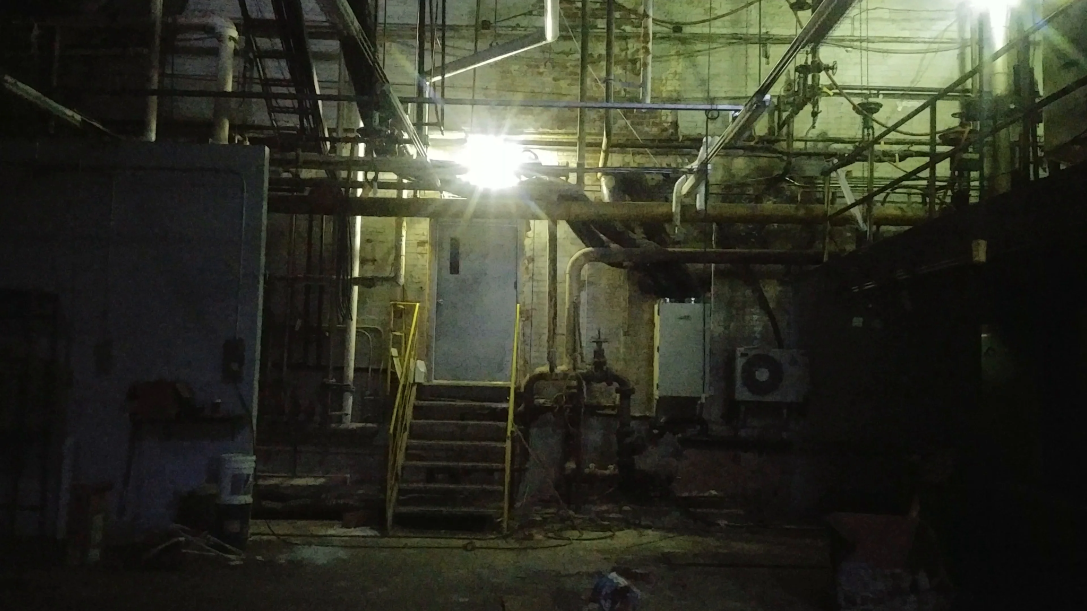
Mode board (Theme and feel)

Slide 3
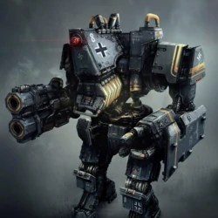
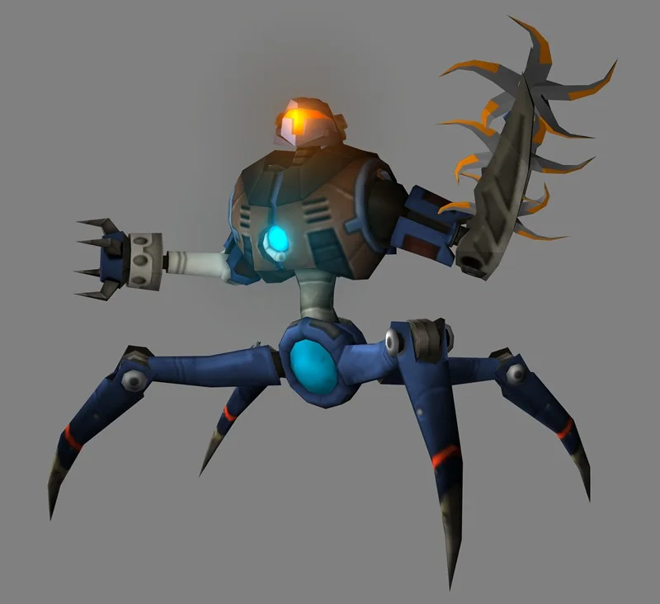
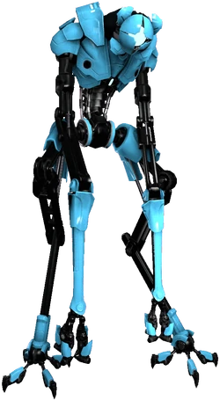
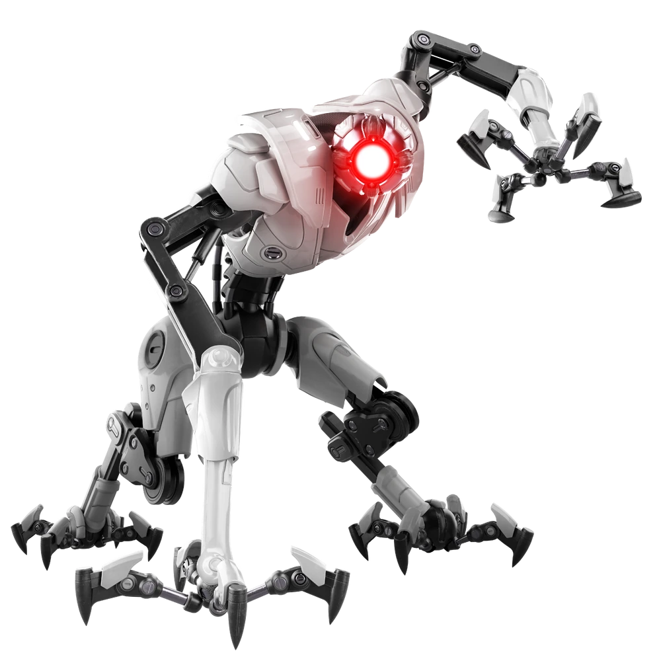
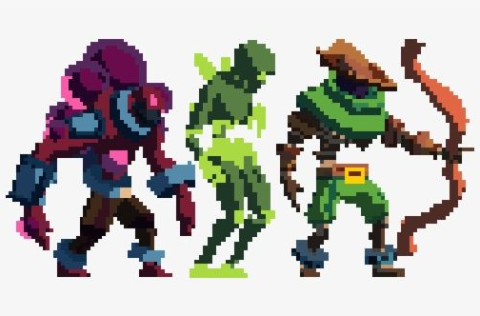
Mode board (Robots or enemies design.)

Slide 4
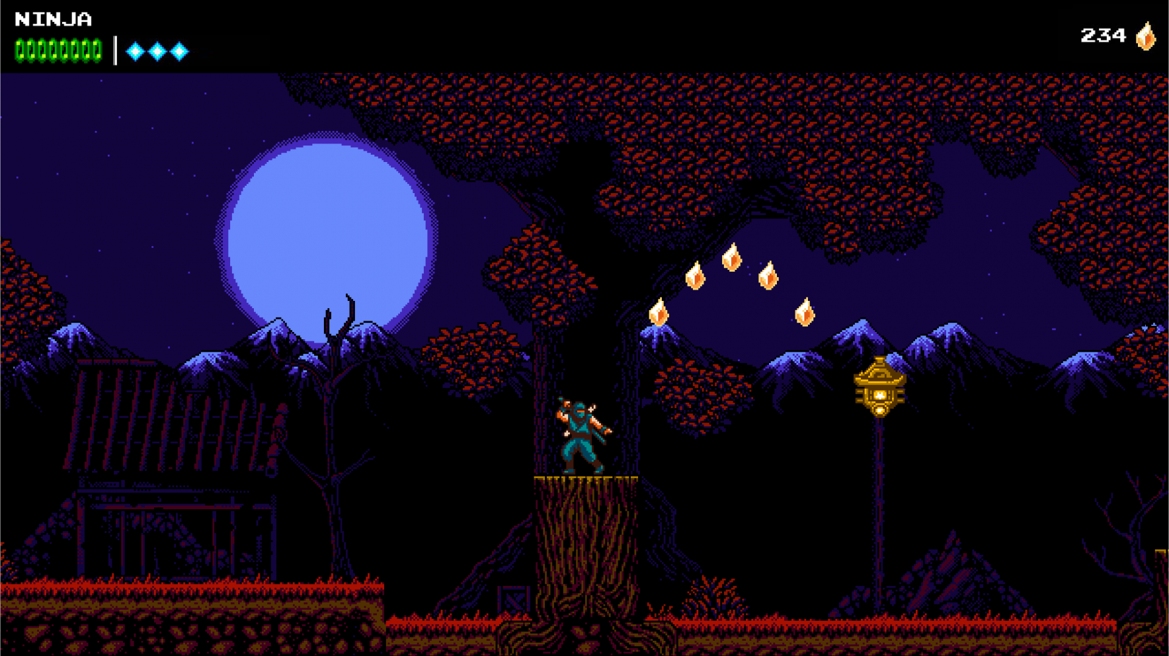
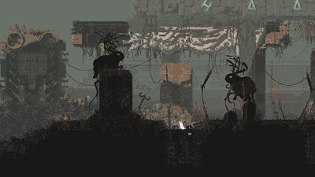
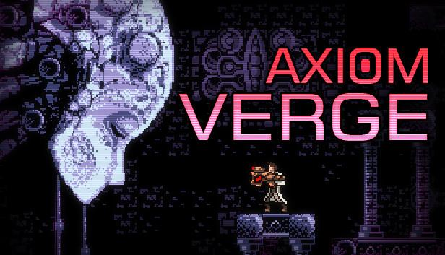
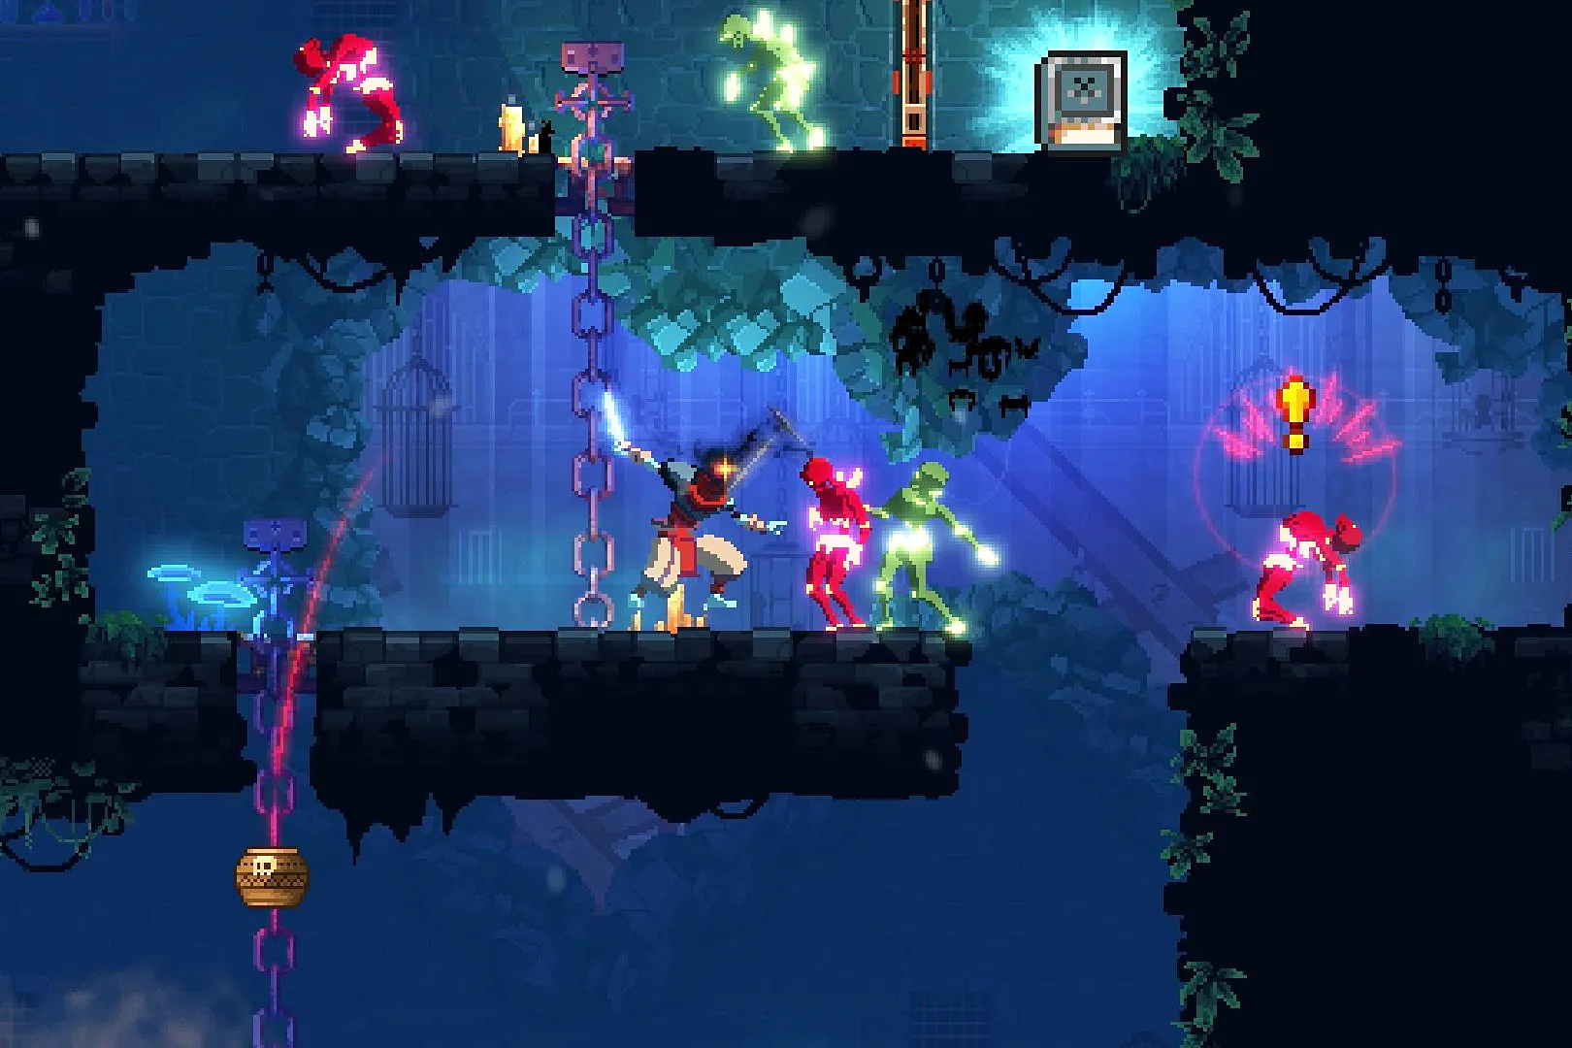
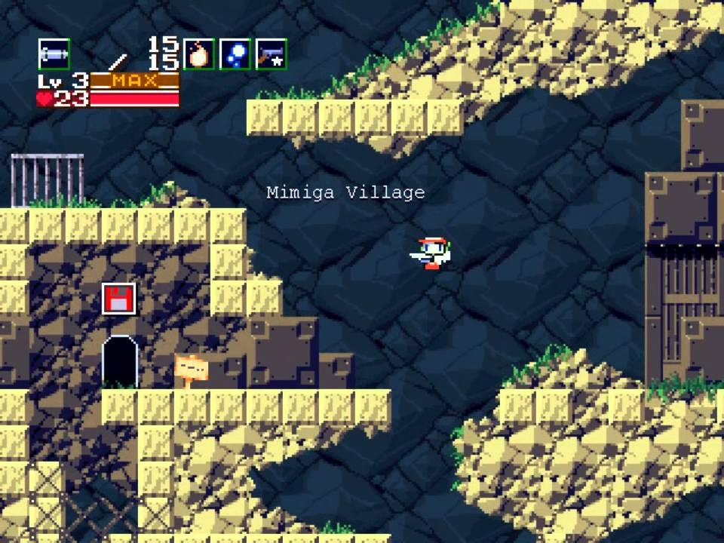
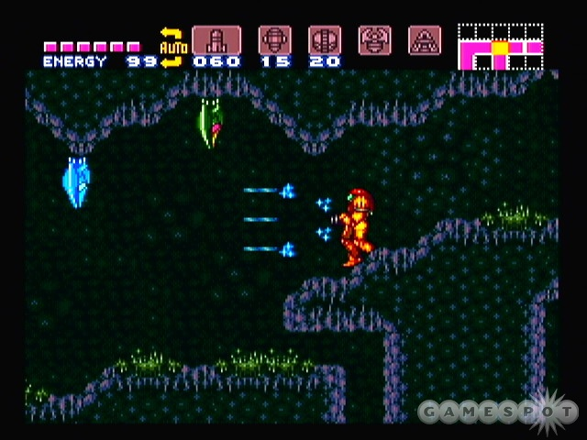
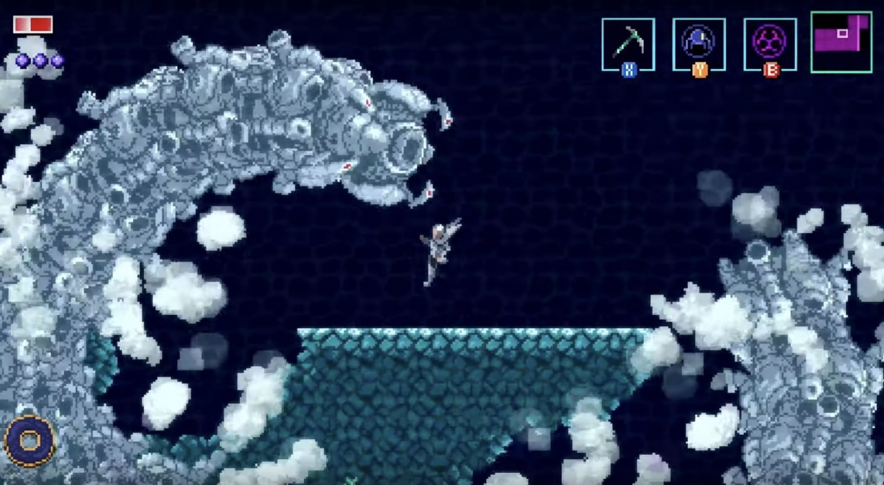
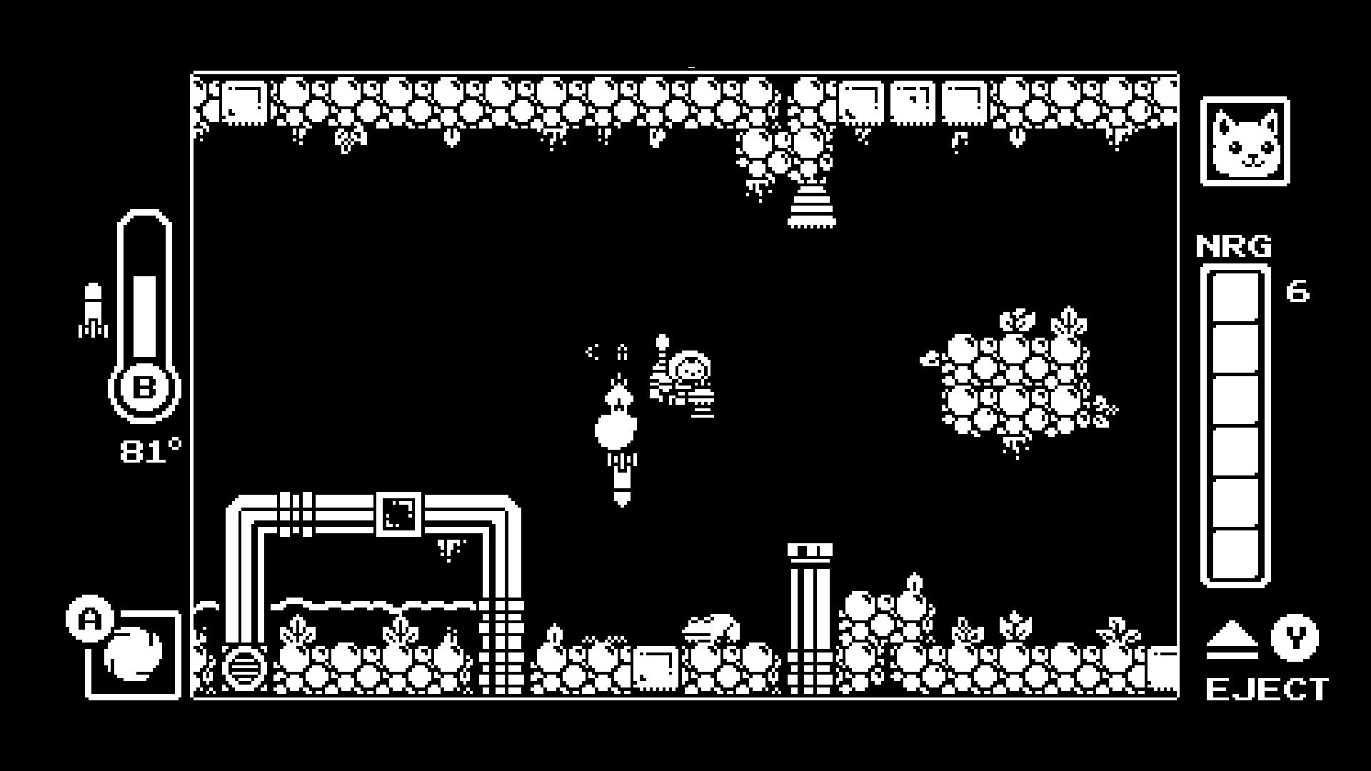
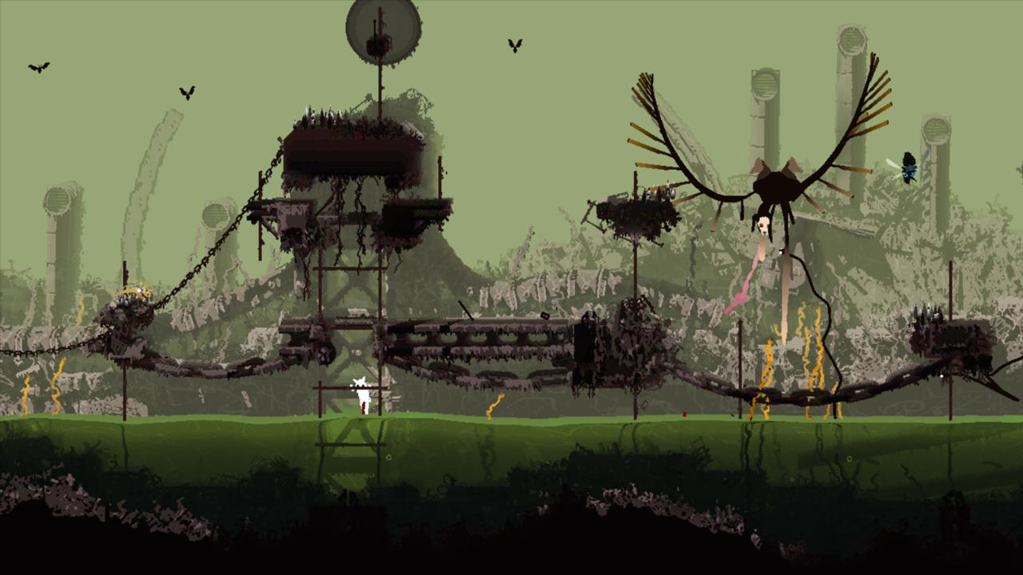
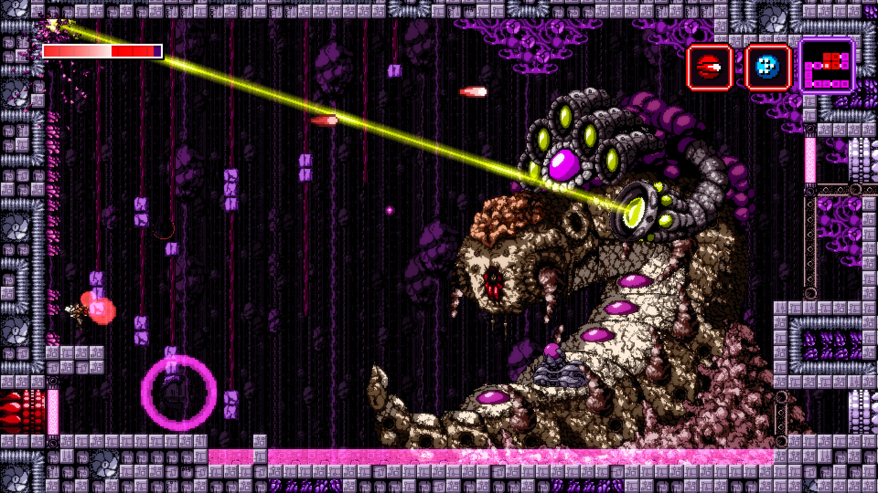
Mode board (Pixel art look)

Slide 5
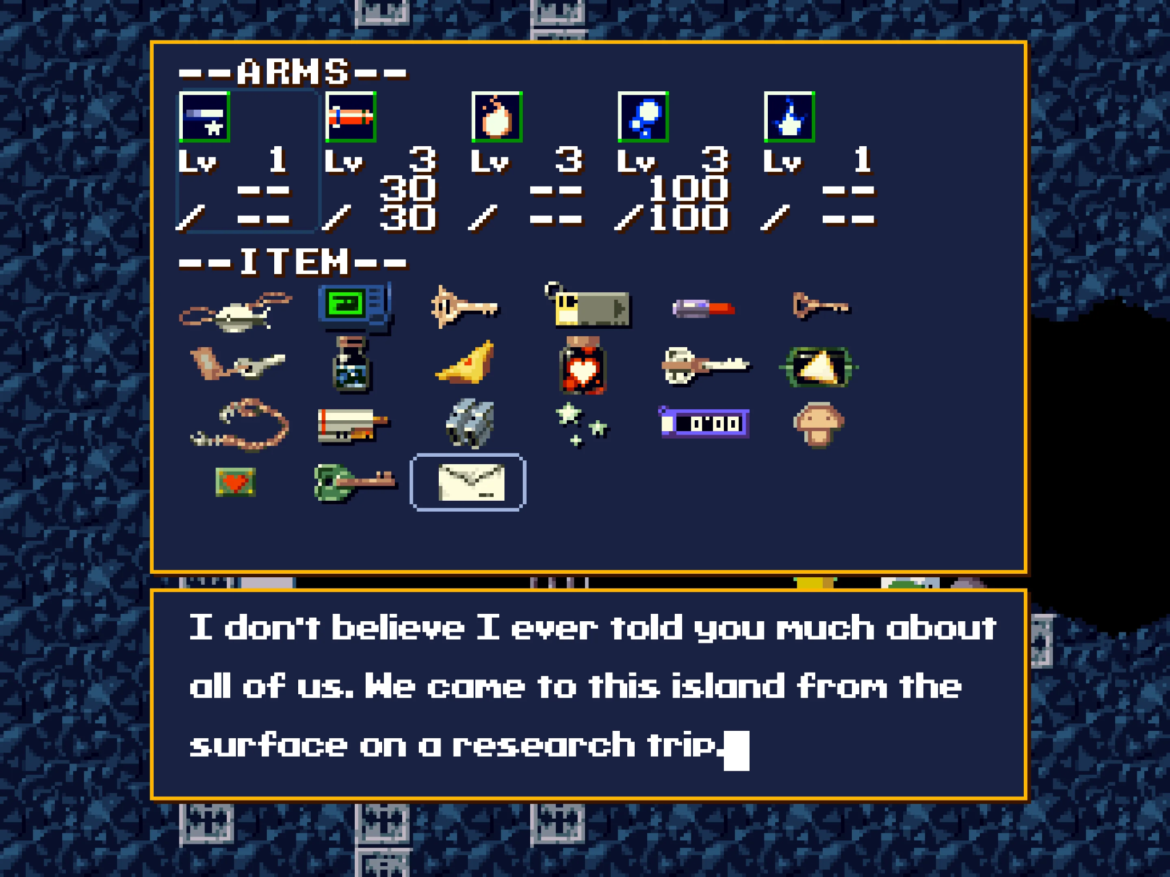
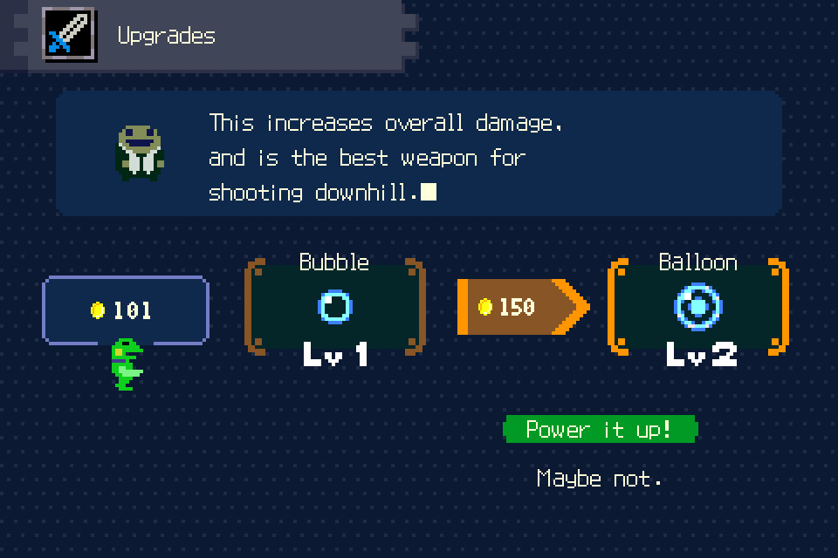
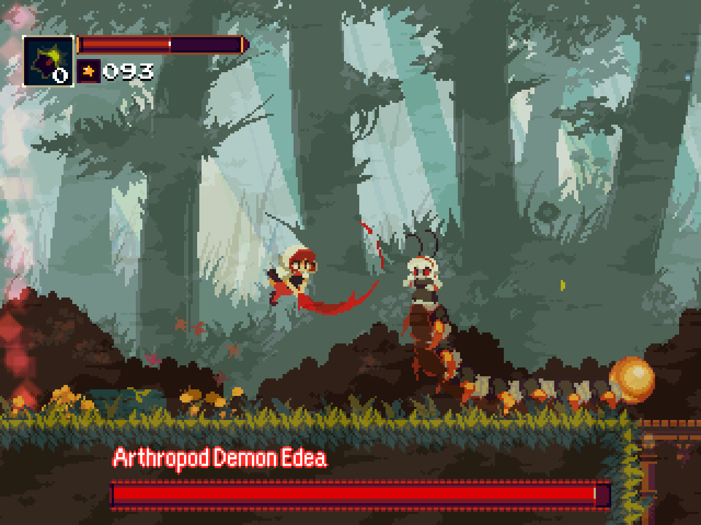
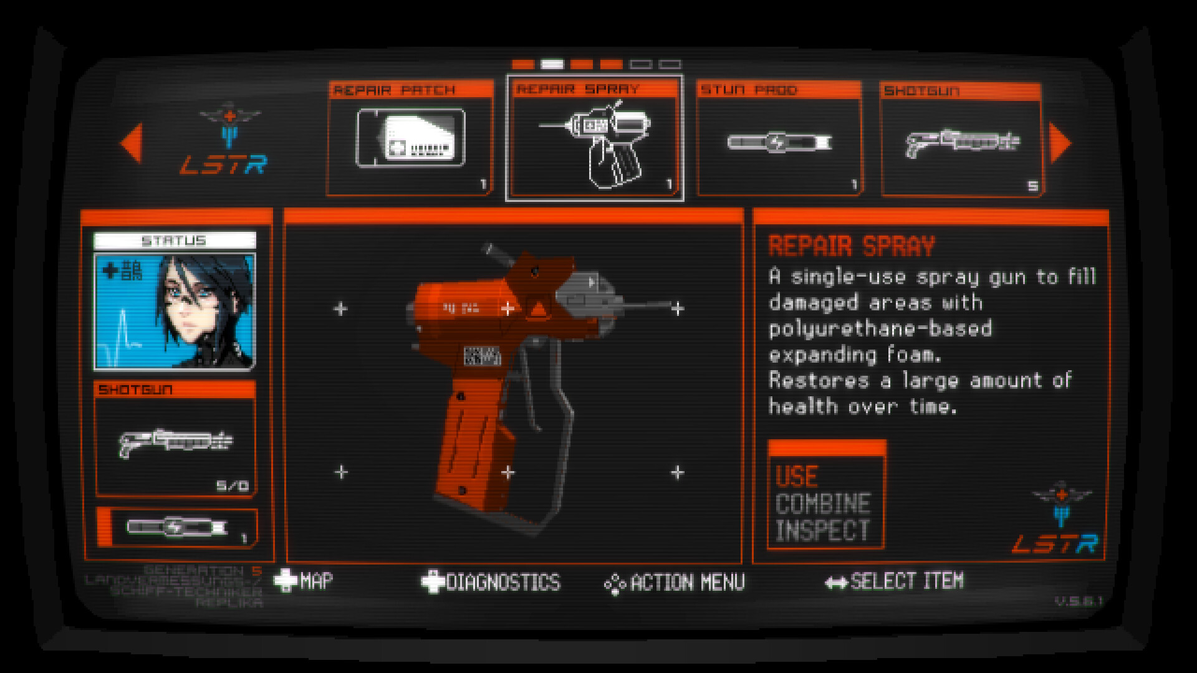
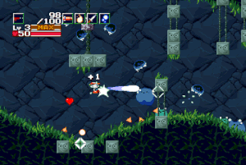
Mood board (UI)

Slide 6
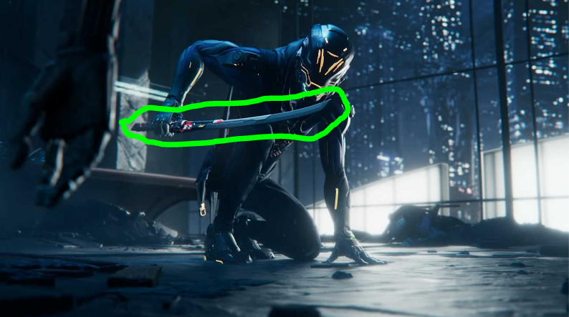
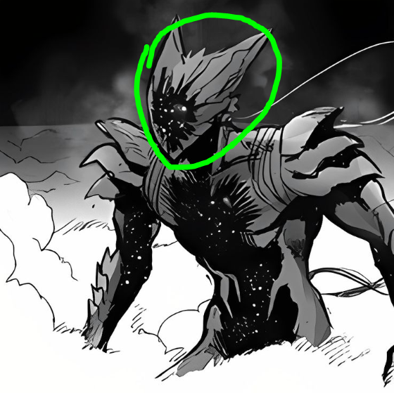
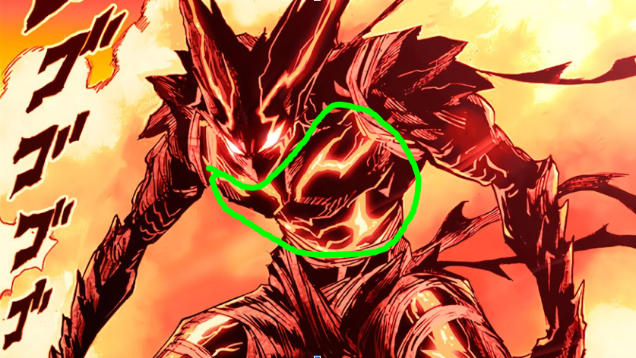
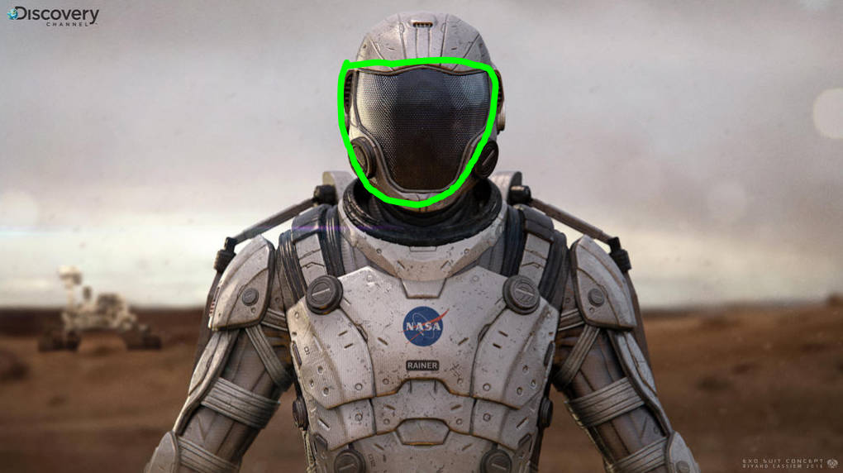
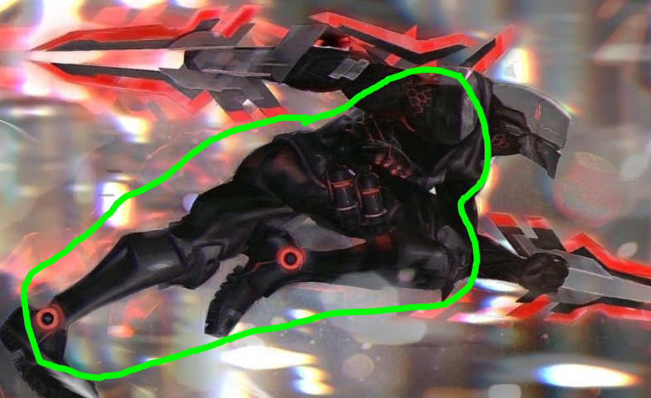
Character design
Bottom right or top right, I like the design of the helmet, I think i would incorporate the viser of the helmet and probably add the bottom left helmet overall outer shell design. Weapon wise, I would say the sword on the very top would be cool. Body design i like the glowing lines on the top left, so I would have to design the main character to have some ventilation that can glow
Notes:
Bottom right or top right, I like the design of the helmet, I think i would incorporate the viser of the helmet and probably add the bottom left helmet overall outer shell design. Weapon wise, I would say the sword on the very top would be cool. Body design i like the glowing lines on the top left, so I would have to design the main character to have some ventilation that can glow

Slide 7
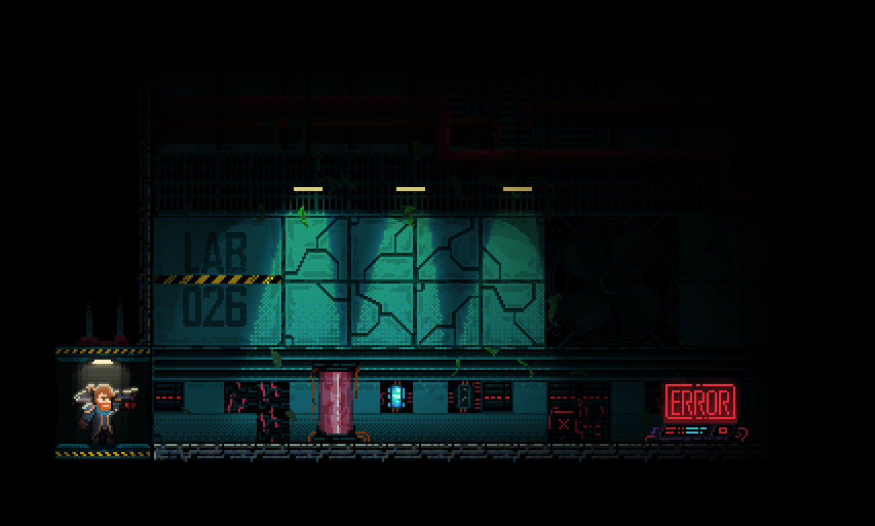
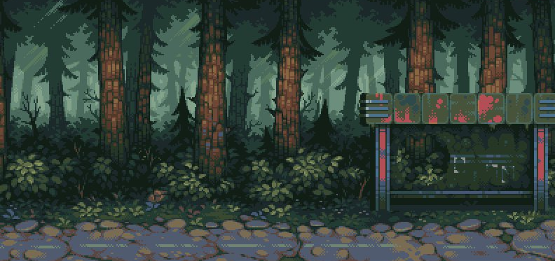
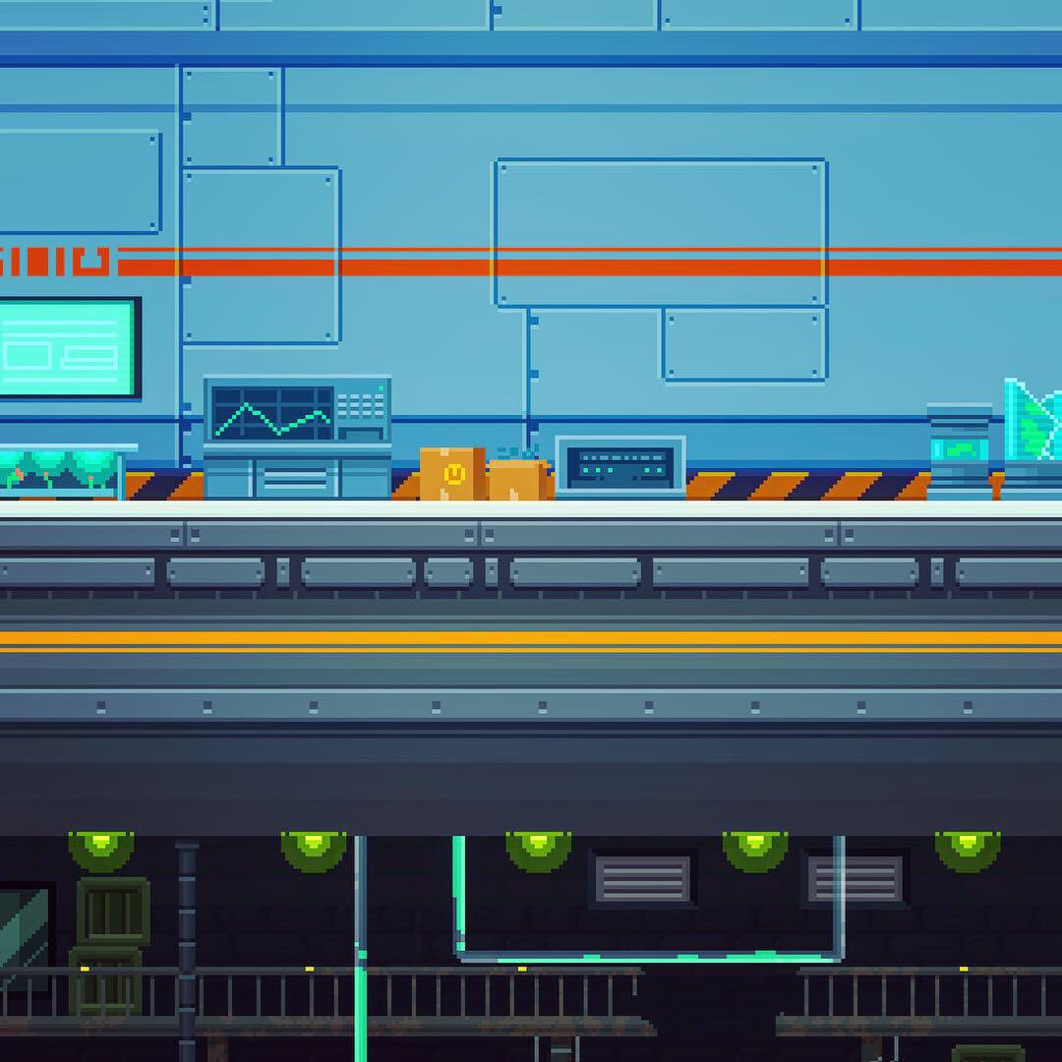
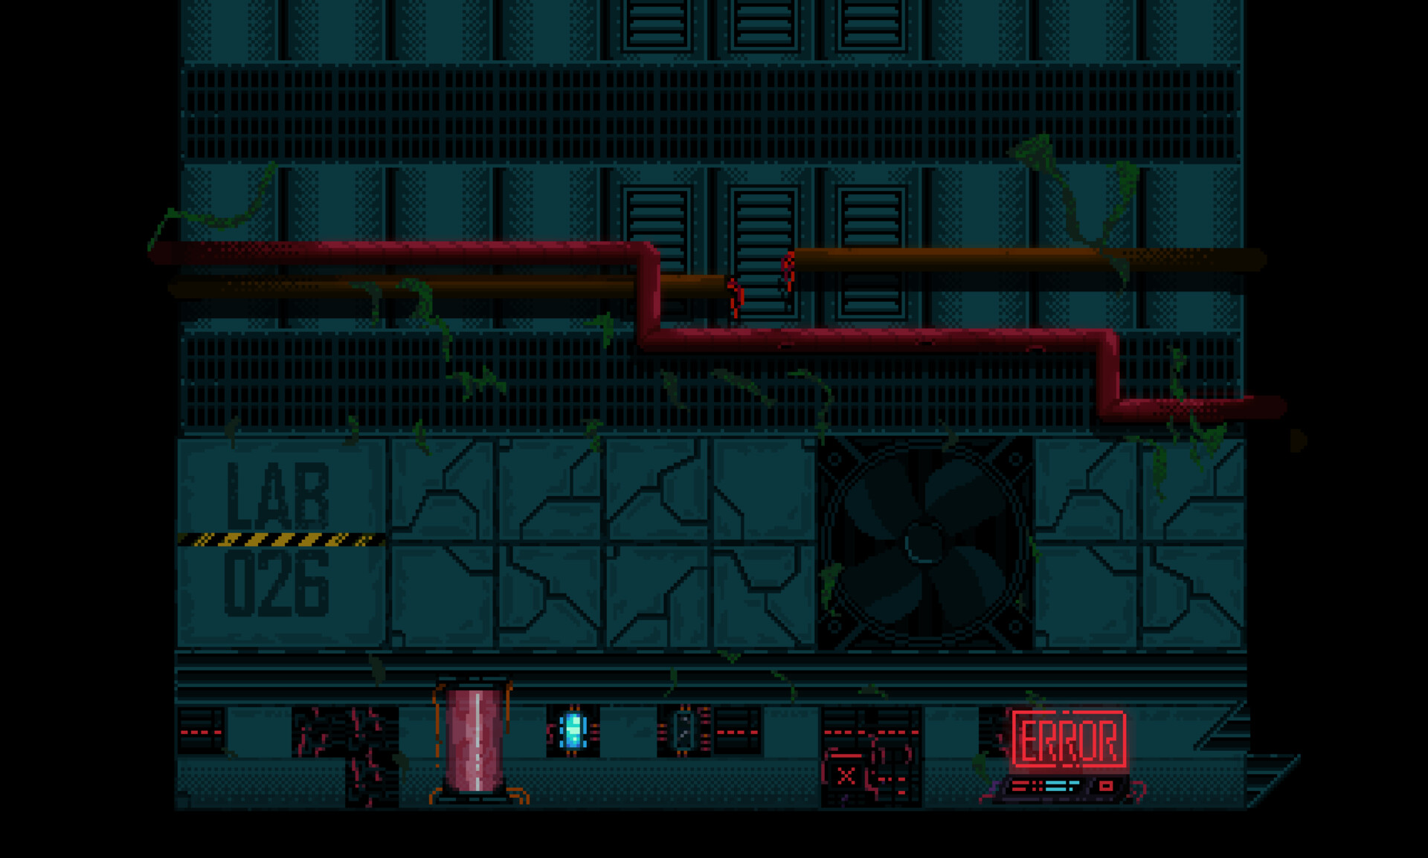
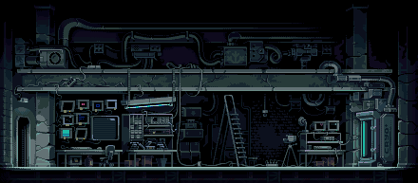
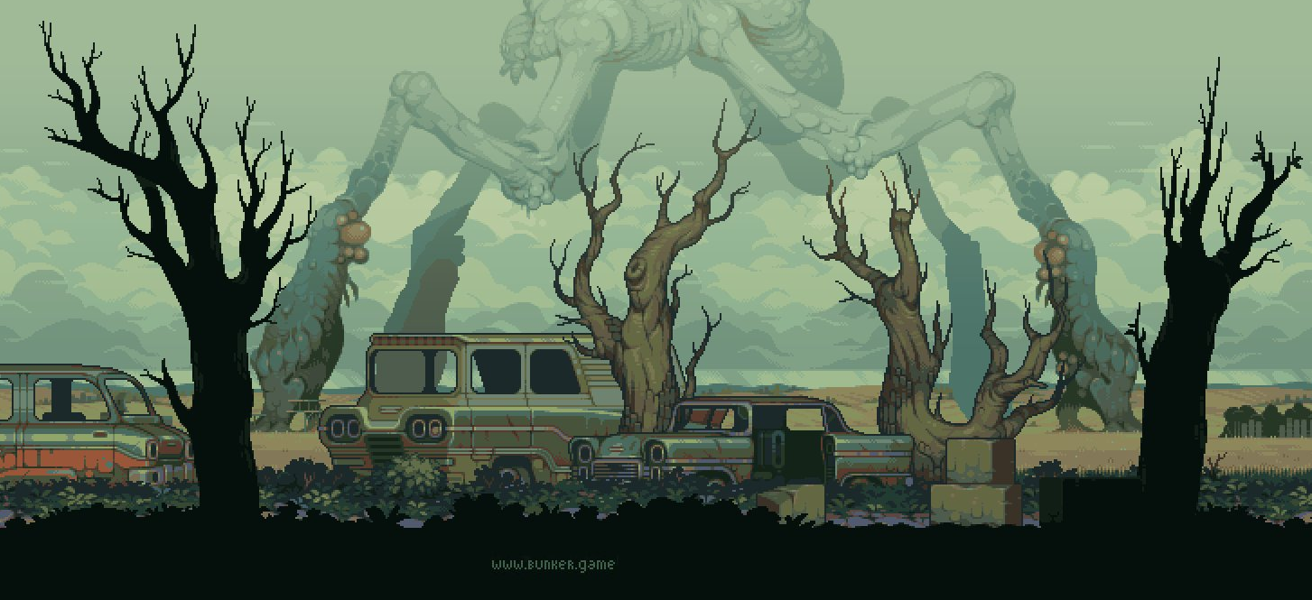
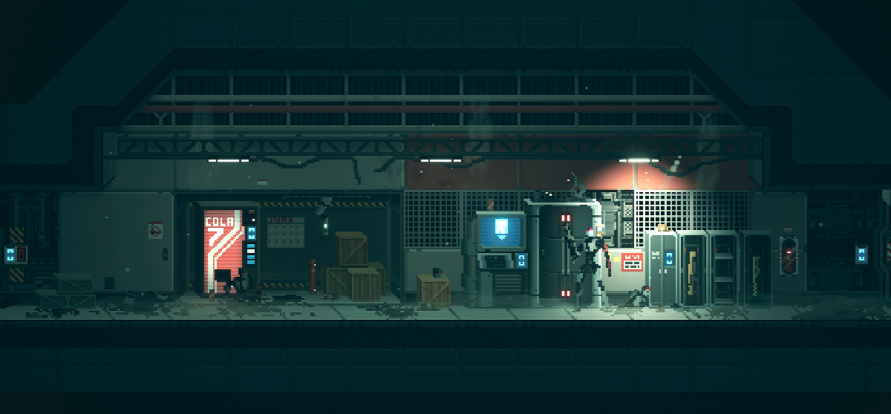
Background of the world and levels.
The forest-like areas are inspiration for the starting point of the game. The decrepit and broken down lab areas symbolize the levels that the player enters first after finding the laboratory building. The more the game progresses, the better quality the lab is in a state of while uncovering the secrets the game holds.
Notes:
The forest-like areas are inspiration for the starting point of the game. The decrepit and broken down lab areas symbolize the levels that the player enters first after finding the laboratory building. The more the game progresses, the better quality the lab is in a state of while uncovering the secrets the game holds.

Slide 8
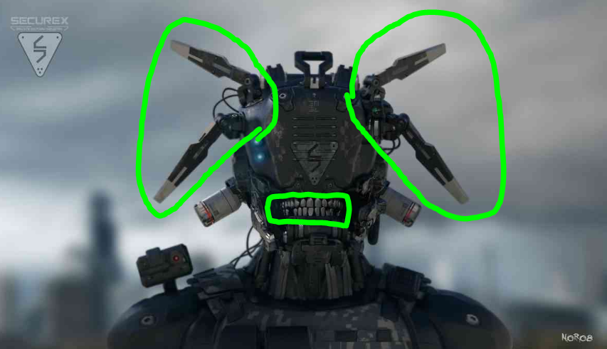
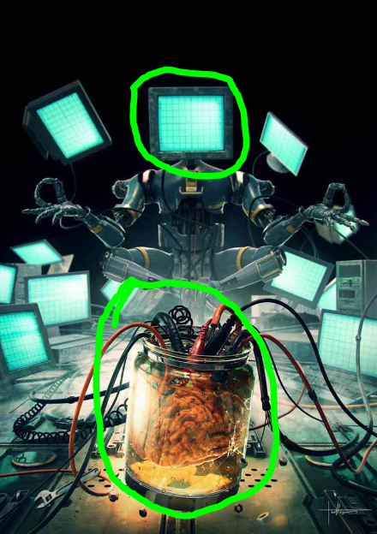
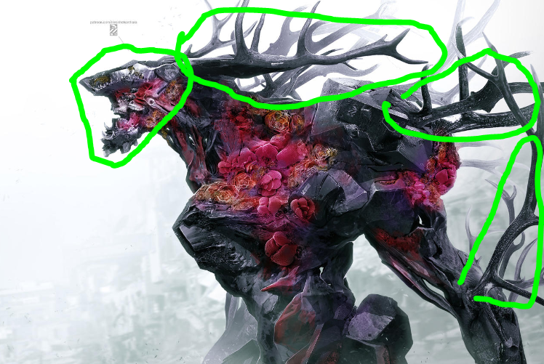
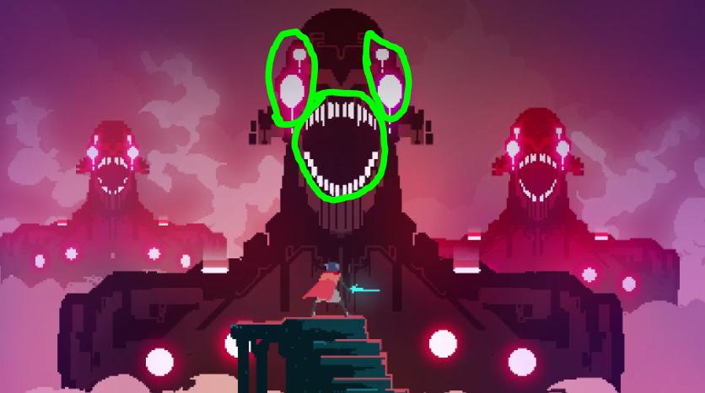
Enemies and Interactable objects.
The one with the tv screens could be the final boss entity that controls all the common enemies. For the enemies that is chasing the player around to make progression more meaningful. I would design a robot that would have like the teeth part showing, and have separated wires dangling off its body.
Notes:
The one with the tv screens could be the final boss entity that controls all the common enemies. For the enemies that is chasing the player around to make progression more meaningful. I would design a robot that would have like the teeth part showing, and have separated wires dangling off its body.

Slide 9
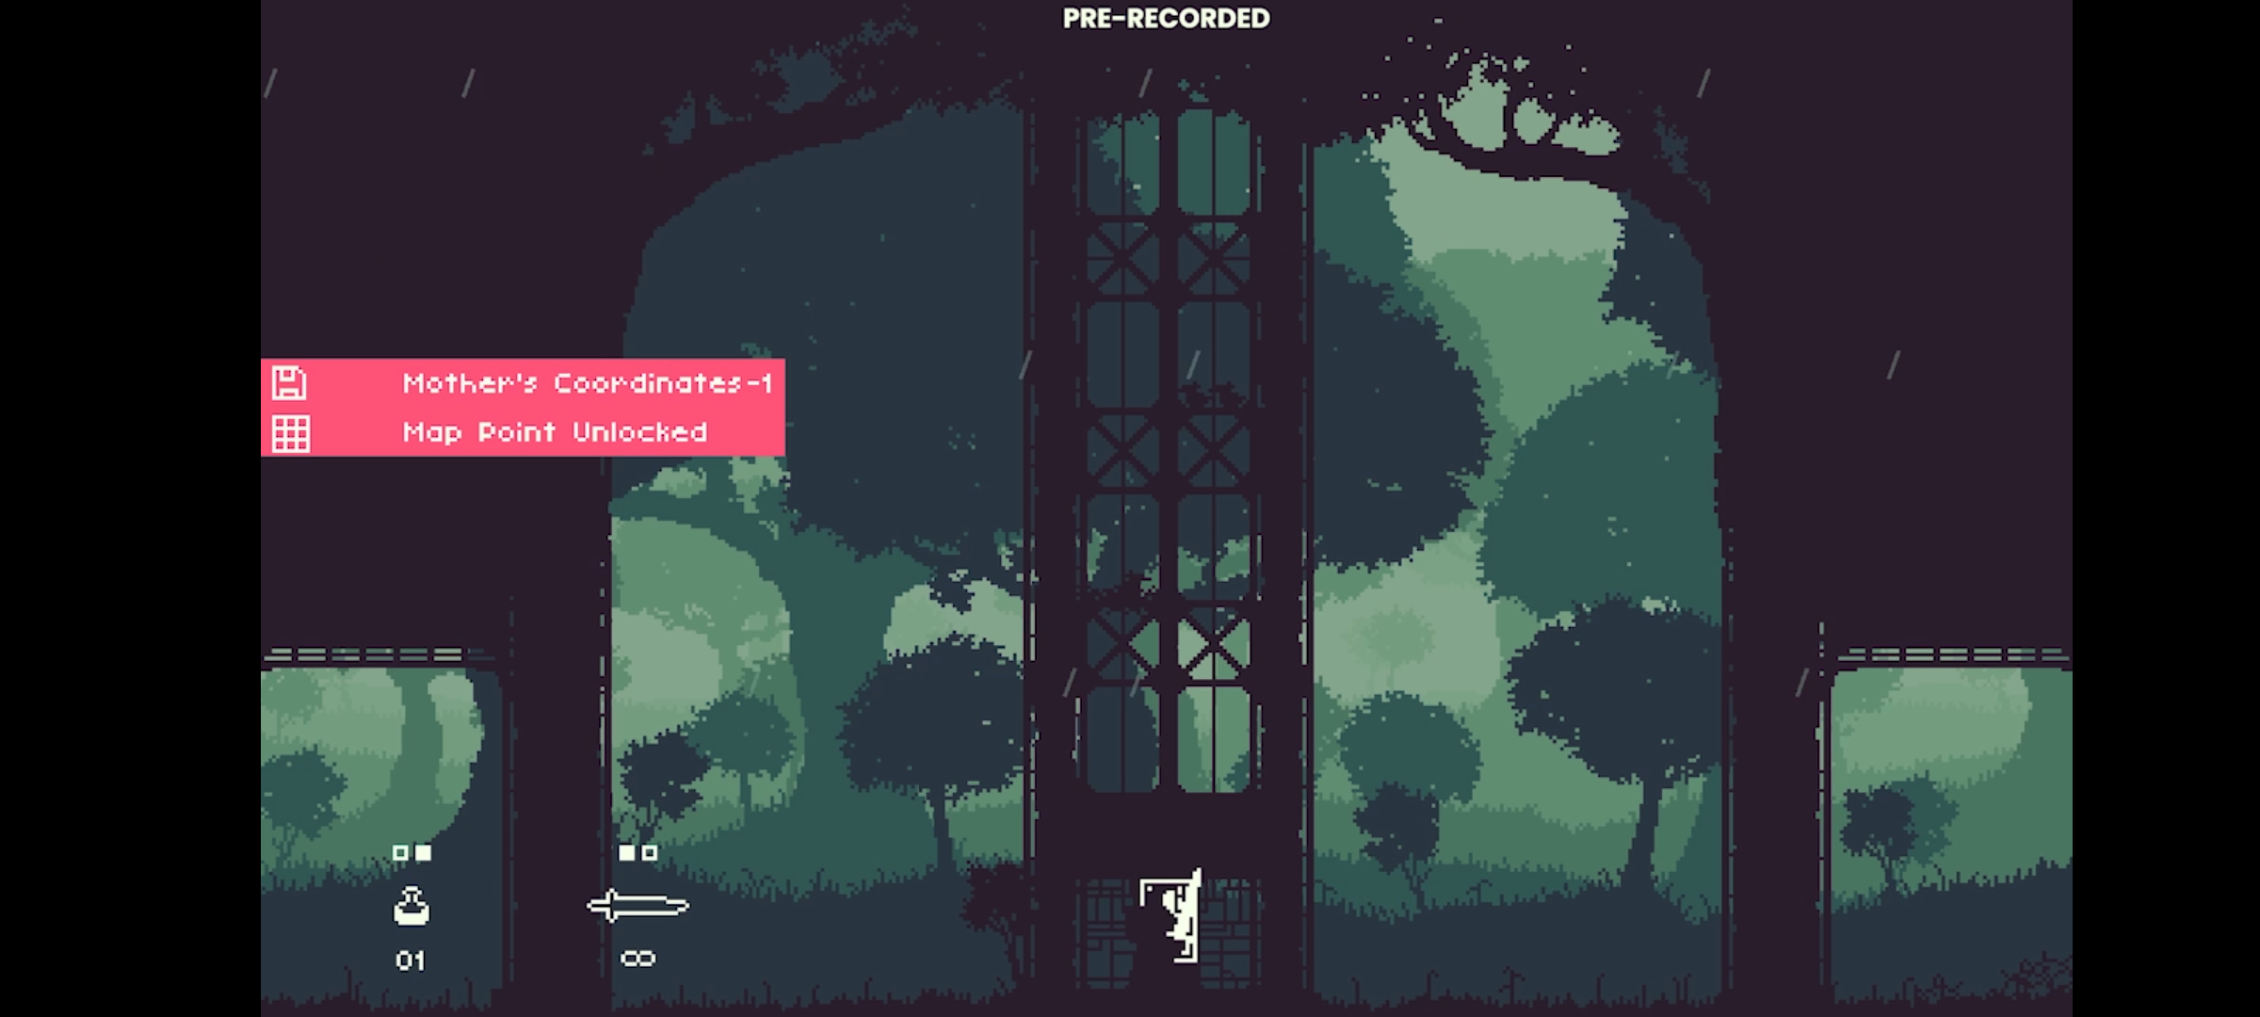
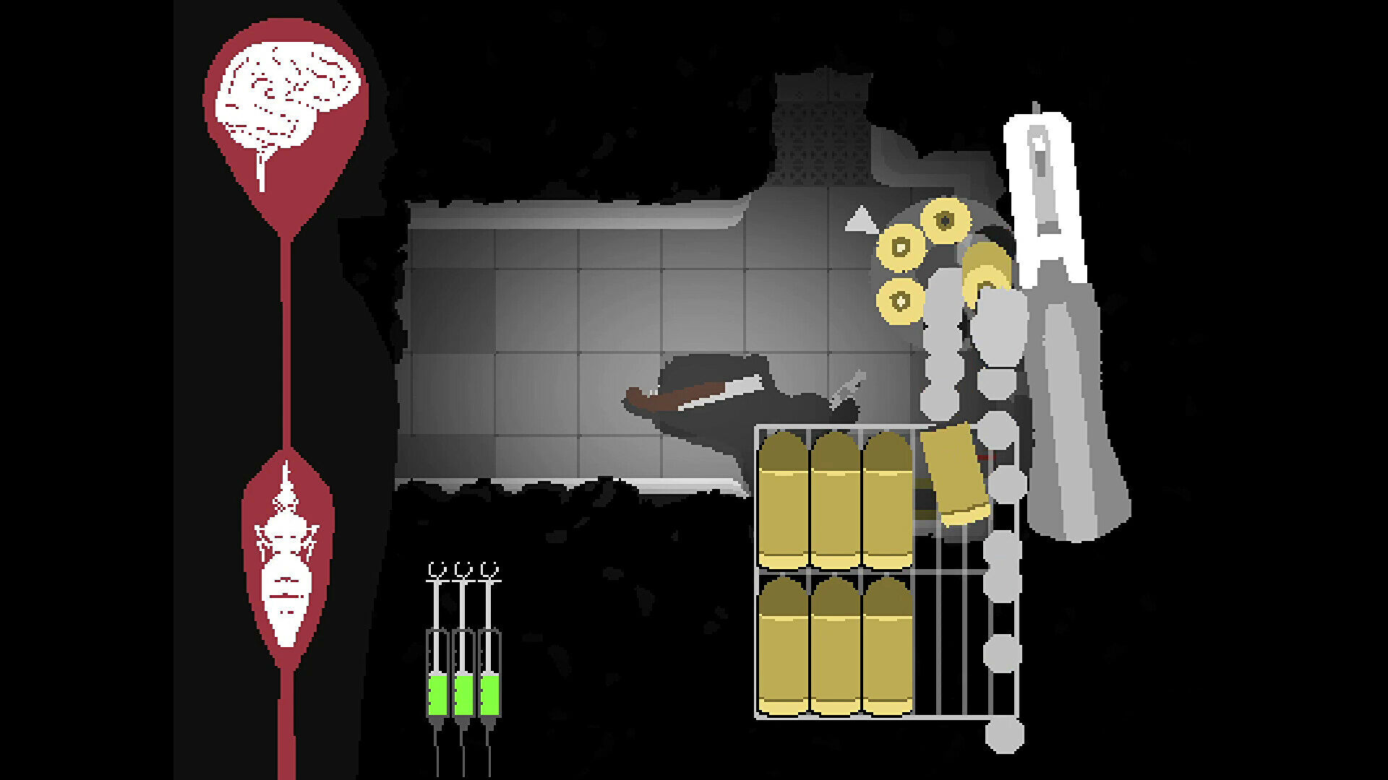
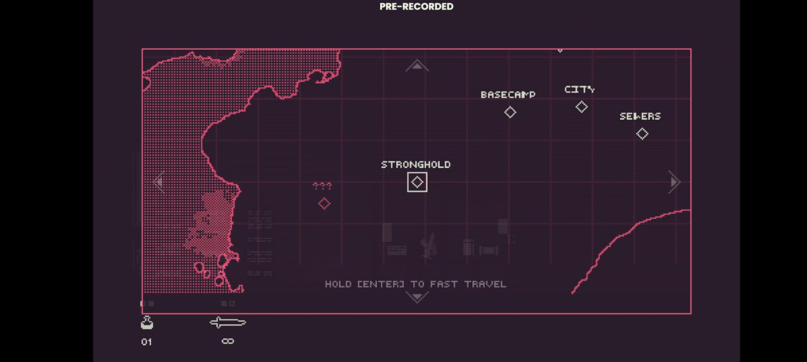
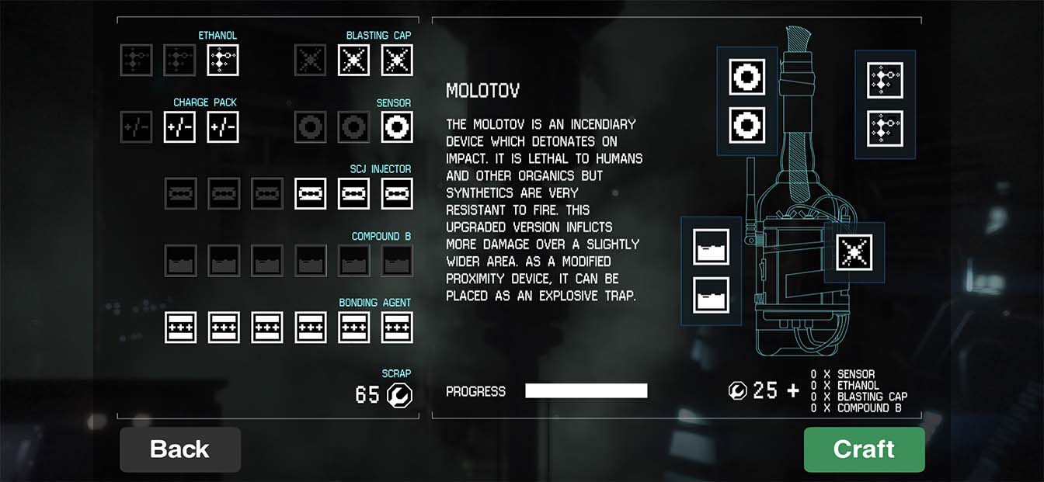
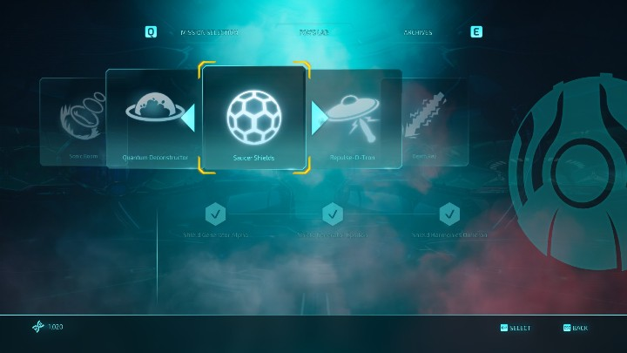
UI
The reason for me choosing these images was because of the minimal and simplistic looks they has. Also they include some aspect related to our genre/ style which includes scifi and Horror.

